Slide 1
Sorting Algorithms
Selection Sort

Slide 2
Complexity issues
The Complexity refers to the number of operations (or time) a given algorithm requires.
We will consider the complexity of different sorting algorithms, to find out how they depend on the size N of the problem.
Usually 3 cases:
  Best case.
  Average case.
  Worst case.
The best algorithm is not always the same one, it may depend on what the input data looks like. And some algorithms are insensitive to the input data, i.e. don’t depend on input data at all.
We now consider some general sorting algorithms that may be applied to a list of sortable data (records).

Slide 3
Selection Sort
This simple algorithm Selection Sort works as follows:
First find the smallest element in array and exchange it with element in 1st position.
Then find the 2nd smallest element and exchange it with element in 2nd position.
Continue in this way with 3rd position, etc until the entire array is sorted.
The method works by repeatedly “selecting” the smallest remaining element in the array.
Property 8.1. Sedgwick. Selection sort uses about N²/2 comparisons and N exchanges.

Slide 4
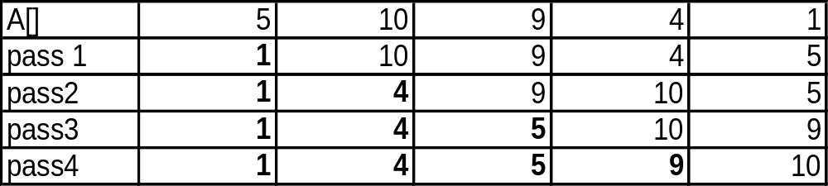
Selection Sort
Example of selection sort on the array A[ ].
After each pass 1 element is in correct position.
current position min position

Slide 5
Algorithm – Selection Sort
Algorithm SelectionSort(A[ ], N)
for i = 0 to N - 2 // pass number = i+1
min = i
for j = i+1 to N – 1 // find the min index in array
if (A[j] < A[min])
min := j // index of minimum value
end if
end for
temp := A[min]; // swap elements at: min and i
A[min] := A[i];
A[i] := temp;
end for
end Selection_Sort

Slide 6
Complexity - Selection Sort
Each pass i needs (N - i) comparisons to find smallest element index.
Total = (N –1)+(N – 2) + …+ 2 + 1= (N-1)N/2  N²/2 comparisons.
Each pass needs one swap to place smallest element in correct position.
Total = (N – 1) swaps.
Selection Sort does not take advantage of partially sorted arrays.
Bubble Sort is about 40% slower than Selection Sort on average.

